Slide 1

Using data science to deliver personalised insights at scale
With benefits for biodiversity monitoring and people
Simon Rolph – simrol@ceh.ac.uk
Notes:
Hello,
I’m going to talk about some work we’ve been doing in the space
This will lead to a workshop

Slide 2
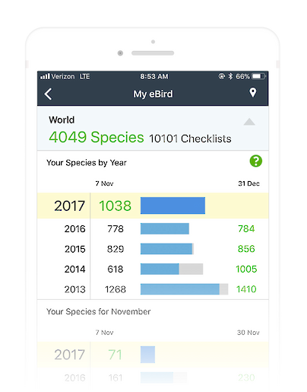
Personalised feedback – part of the solution?
Butterfly monitoring is vital for biodiversity data and policy
Volunteer recorders are the backbone of this effort
Challenge: Engagement and data quality can vary
  → Personalised feedback to build engagement and improve data?
Notes:
Butterfly monitoring is essential for biodiversity and policy.
Volunteers are the backbone of this effort.
Challenge: engagement and data quality vary.
Pose the question: Could personalised feedback help improve engagement and data quality?

Slide 3
Data centric
Recorder centric
Notes:
One thing we want to consider when designing feedback
Highlight the shift from focusing solely on data to considering recorder experience.
Emphasize that both perspectives matter for long-term success.

Slide 4
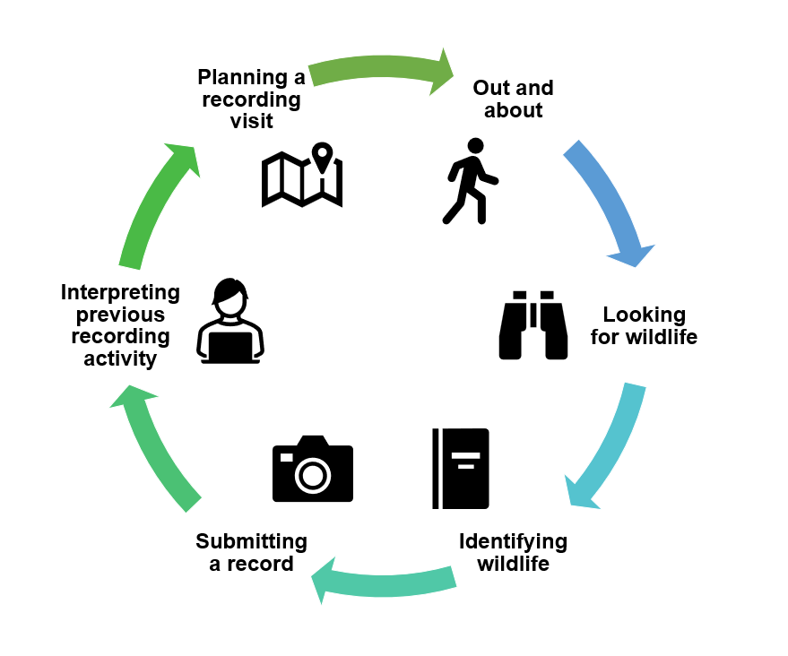

Slide 5
The journey so far…
Generating evidence and developing tech solutions

Slide 6
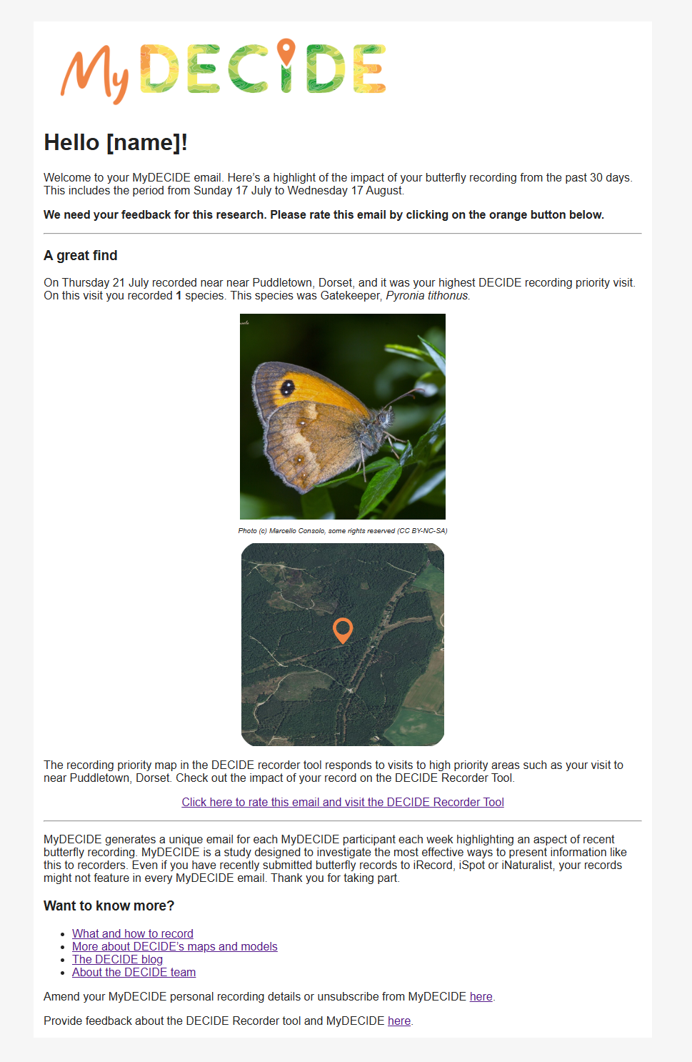
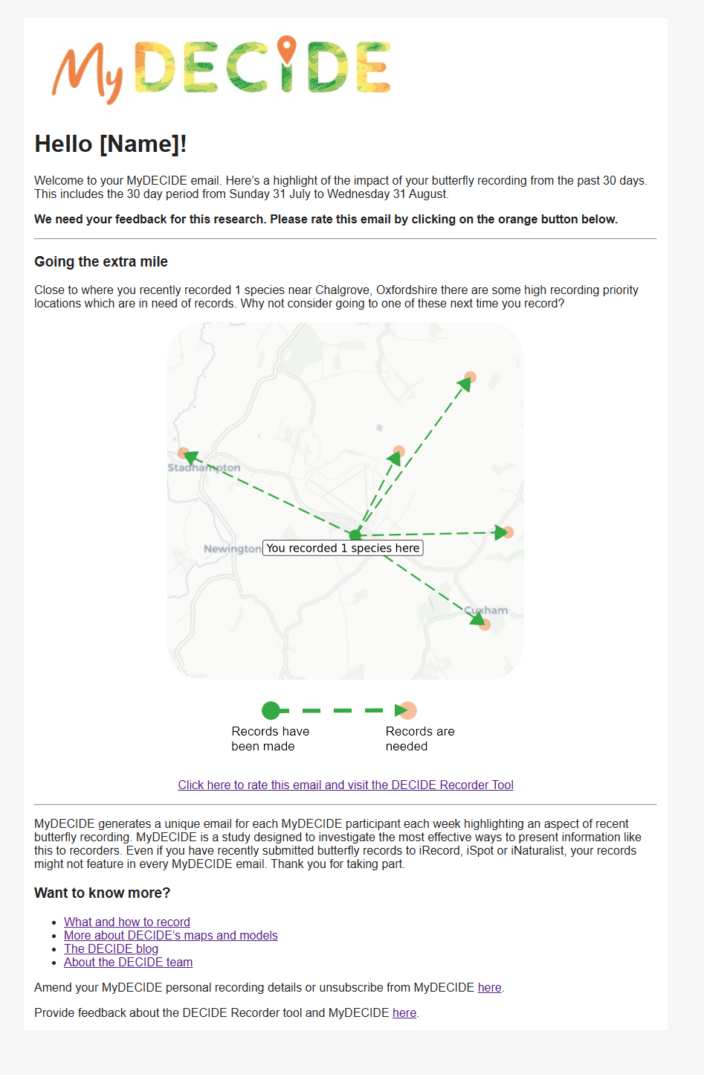
2022
850 recipients
~weekly emails

Slide 7
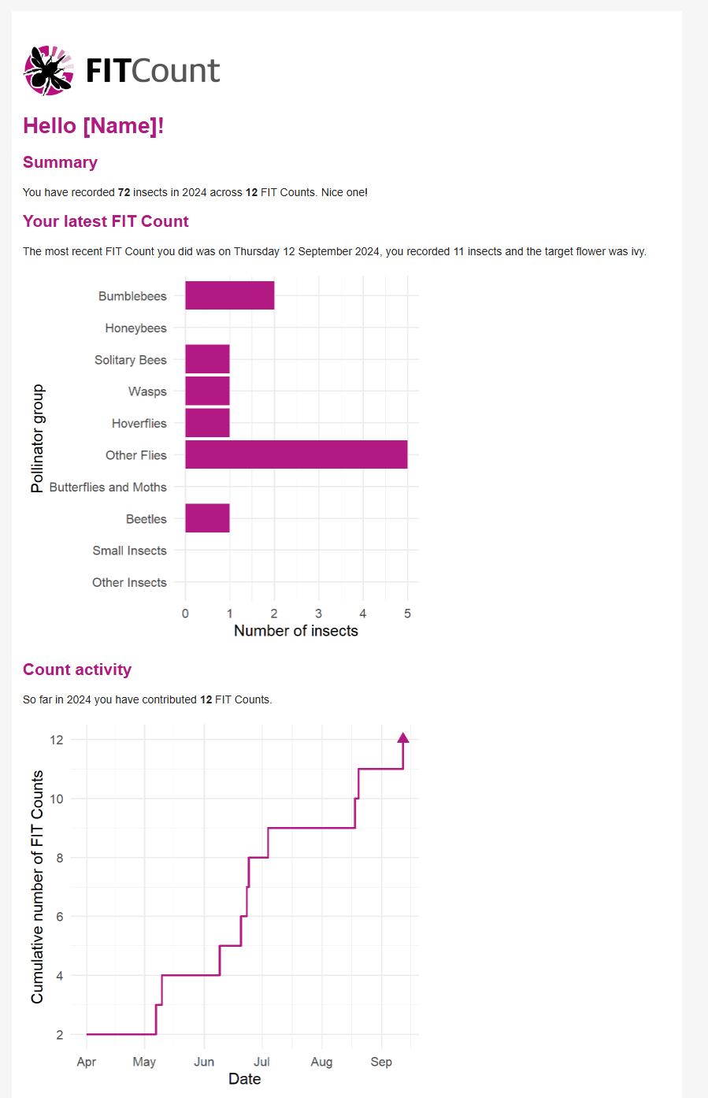
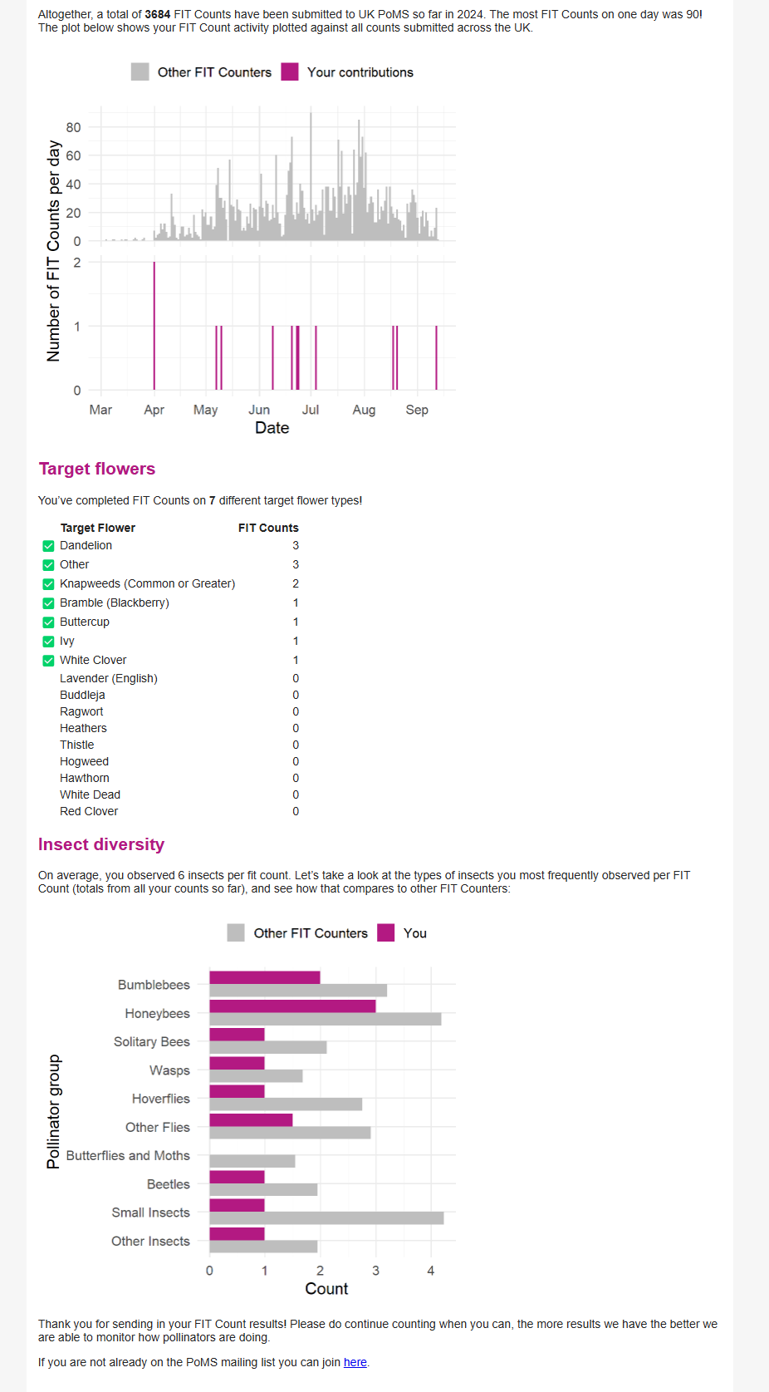
2024
Interviews and
prototyping
2025
~1000 recipients
2 emails

Slide 8
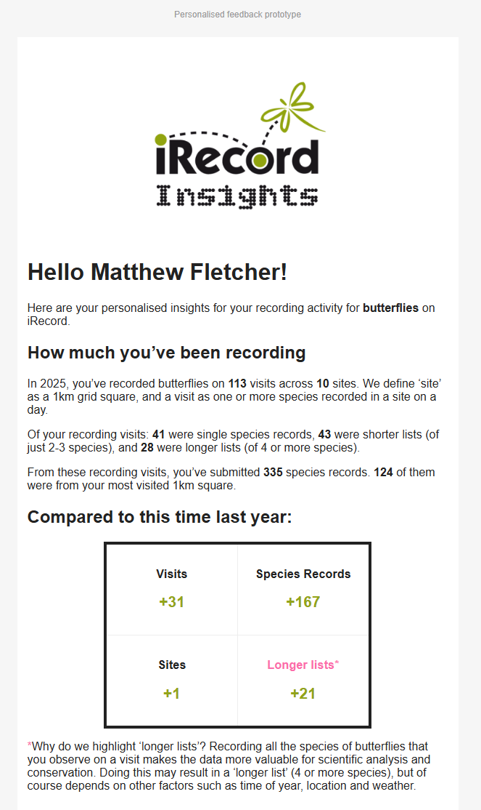
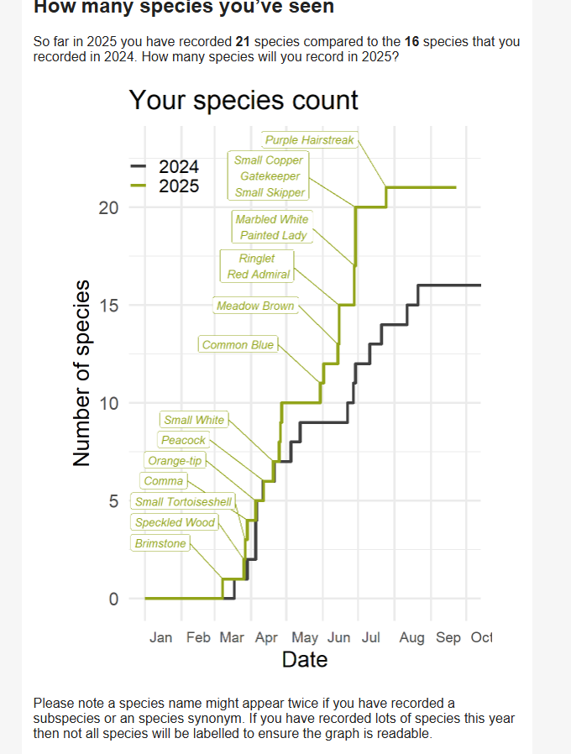
2025
Experiment,
~1500 participants,
4 groups (including control), questionnaire
Analysing data now

Slide 9
The findings so far: motivating, but limited evidence of behaviour change
“It's nice to have some recognition and feedback”
“I appreciated that my records were of value”
“It made me more determined to record more”
“It made me feel I was making a contribution, so encouraged me to continue recording”

Slide 10
What’s next for this work under EMBRACE?
Co-designing templates for feedback and insights
User research though interviews and questionnaire
2025
2026
2027

Slide 11
With that in mind… over to you!
Purpose: Explore how we could use automated feedback/insights to engage butterfly recorders and improve data quality.
Breakout Structure (50 mins):
  Ideation (15 mins) - Brainstorm ambitious ideas
  Prioritisation (10 mins) - Assess ideas for impact & feasibility, select one idea to develop
  Design (25 mins) - Create a visual concept
12:10 – Groups share their ideas
12:40 – Lunch 🍴

